Slide 1
Face Recognition Algorithm Based on VGG Network Model and SVM
Đào Việt Duy – MSSV:
Nguyễn Duy Hàn Lâm – MSHV: 196005004

Slide 2
Citation
Dataset:
R Vemulapalli, A Agarwala, “A Compact Embedding for Facial Expression Similarity”, CoRR, abs/1811.11283, 2018.

Slide 3

CNN

Slide 4
Convolution layer

Slide 5
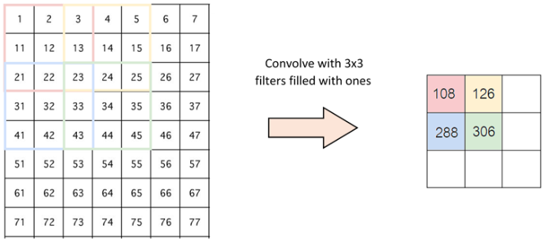
Stride - padding

Slide 6
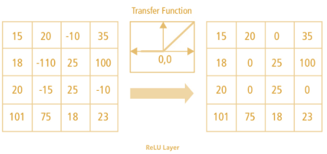
Softmax function

Slide 7
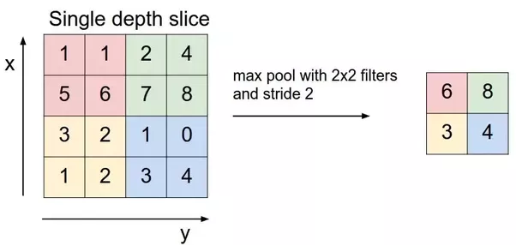
Pooling layer

Slide 8
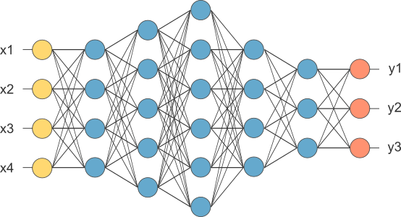
Fully connected layer

Slide 9
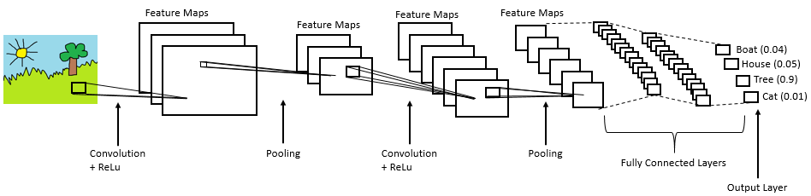

Slide 10
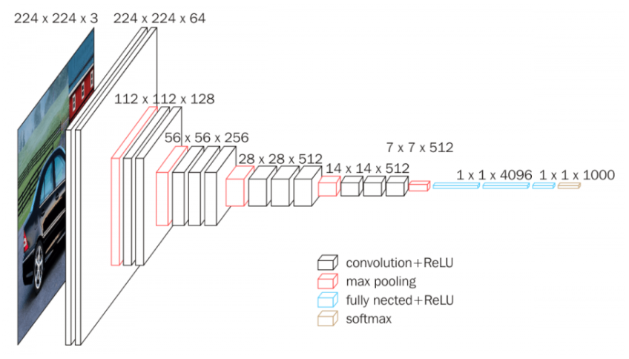
VGG16 model concept

